Slide 1

Principles of Machine Learning DSA 5105 • Lecture 1
Soufiane Hayou
Department of Mathematics

Slide 2
Logistics
Instructor Soufiane Hayou (Department of Mathematics) Office: S17-05-08 Email: hayou@nus.edu.sg
Notes, slides and code are/will be available on Canvas
Assessment
Homework (3 x 5%) + Project (15%) (Individual) [30%]
Mid-term Test [20%]
Final Exam [50%]

Slide 3
Logistics
Lectures
F2F (LT28) + Live(Zoom) + Recording will be uploaded
You are encouraged to turn on your camera (if you’re following with Zoom)
Active participation is encouraged.
Consultation arrangement will be announced later

Slide 4
Introduction

Slide 5
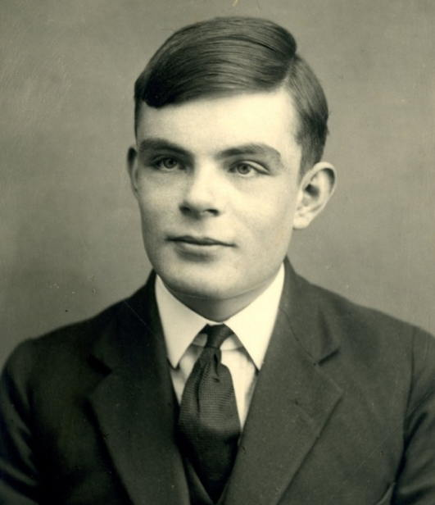
Can machines think?
I propose to consider the question, “Can machines think?”. This should begin with definitions of the meaning of the terms "machine" and "think." The definitions might be framed so as to reflect so far as possible the normal use of the words, but this attitude is dangerous…
Alan Turing, 1950
Turing, A. M. “Computing machinery and intelligence”. Mind 49 433-460.
Notes:
Why is it dangerous? Because the word “machine” makes an unimportant distinction. The word “think” is not well-defined. A formalization of this problem is required…

Slide 6

The Imitation Game
I believe that in about fifty years' time it will be possible, to programme computers … to make them play the imitation game so well that an average interrogator will not have more than 70 percent chance of making the right identification after five minutes of questioning.
Alan M Turing, 1950
https://en.wikipedia.org/wiki/Turing_test#/media/File:Turing_test_diagram.png

Slide 7
From artificial intelligence to machine learning
Can machines think?
Can machines do what thinking beings do?
How can machines learn to do some things that thinking beings do?
Notes:
The first step represents a formalization of AI.

Slide 8
In this class, we are interested in the study of algorithmic approaches to learning

Slide 9
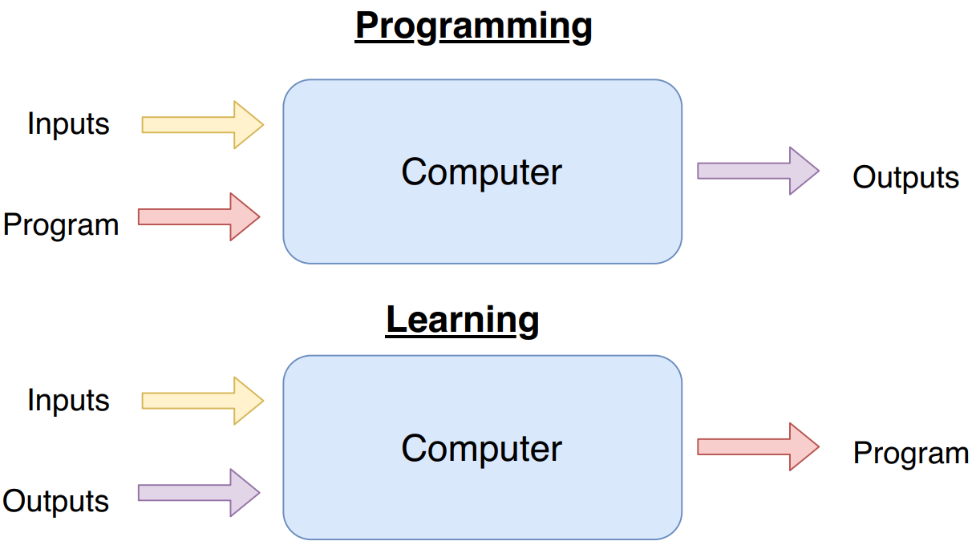

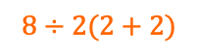
A concrete definition of learning
A computer program is said to learn from experience E with respect to some class of tasks T and performance measure P if its performance at tasks in T, as measured by P, improves with experience E.
Tom Mitchell
$$8÷2(2+2)$$
16
calc(*args)
$$8÷2(2+2)$$
calc(*args)
16
Notes:
Does it have to be a computer program?

Slide 10
Common objection: Machine learning is not science!

Slide 11
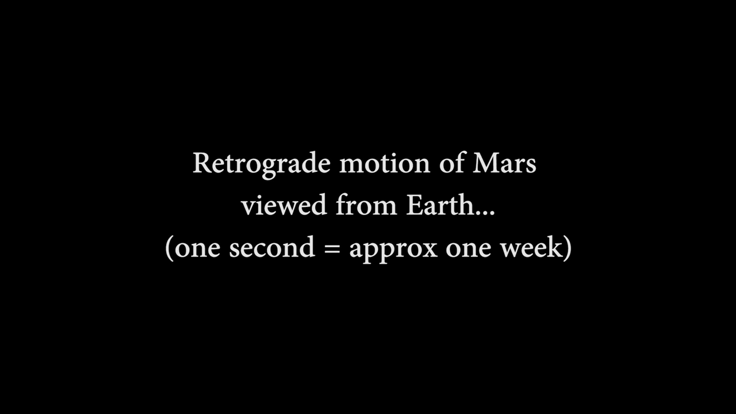
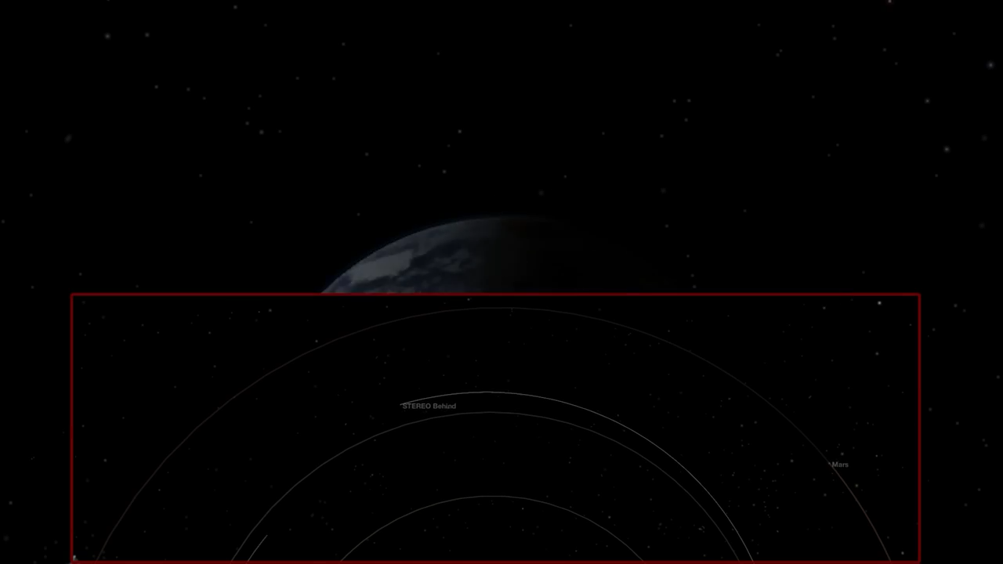
Wanderers in the sky
Ancient astronomers observed that there are some “stars” that wander about in retrograde motion. The ancient Greeks named them πλανῆται, which means wanderers.
https://www.youtube.com/watch?v=TK9ozJYELR8

Slide 12
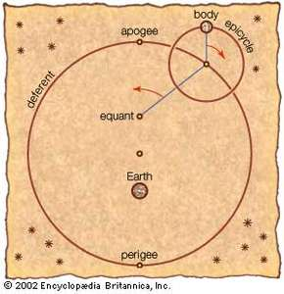
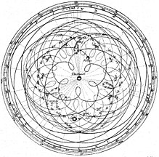
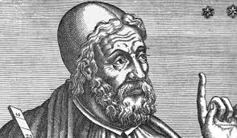
Ptolemy’s model of planetary motion
Ptolemy’s geocentric model (~100 AD) is perhaps one of astronomy’s first foray into data science
More circles
https://en.wikipedia.org/wiki/Geocentric_model#Ptolemaic_model

Slide 13
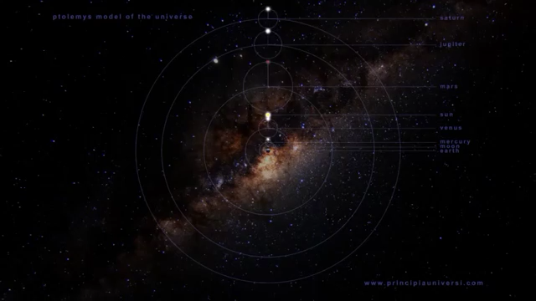
Ptolemy’s model of planetary motion
https://www.youtube.com/watch?v=EpSy0Lkm3zM

Slide 14
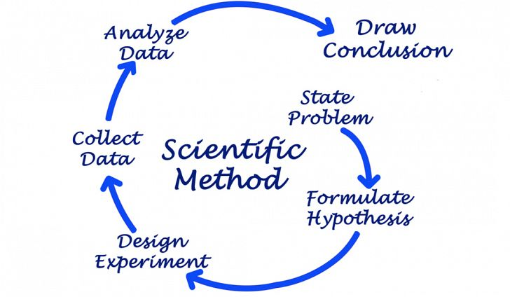
Machine learning and the scientific method
Machine learning
Automation
Computers
Often from data
https://www.worldatlas.com/articles/what-is-the-scientific-method.html

Slide 15
Topics
Supervised learning
Linear and nonlinear models
Basic learning and approximation theory
Learning/optimization algorithms
Unsupervised learning
Dimensional reduction, clustering and generative models
Reinforcement learning
Markov decision processes, reinforcement learning algorithms

Slide 16
What this class is
A (hopefully) gentle introduction to the exciting world of machine learning
A holistic view of the modern interplay of machine learning with mathematics, statistics, computer science, physical sciences and engineering
What this class isn’t
A comprehensive survey of state-of-the-art machine learning models and methods
A “math class”

Slide 17
Preliminaries

Slide 18
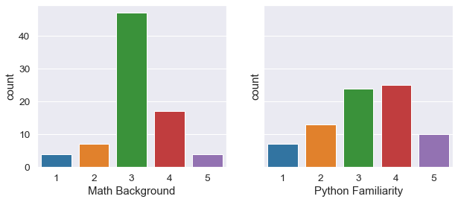
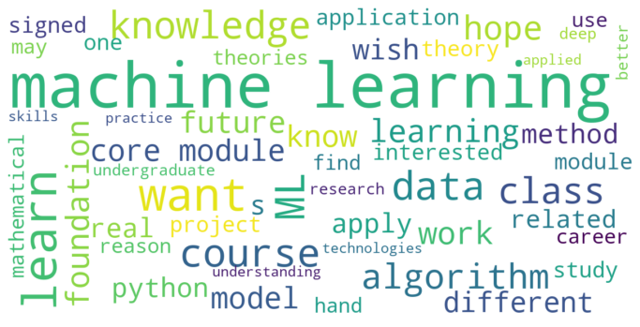
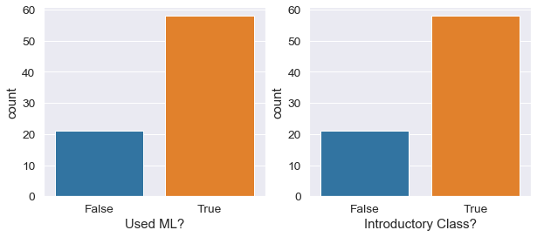
Types of data (from our survey)
Math/Python background
Used ML before? Introductory Class?
Expectations

Slide 19

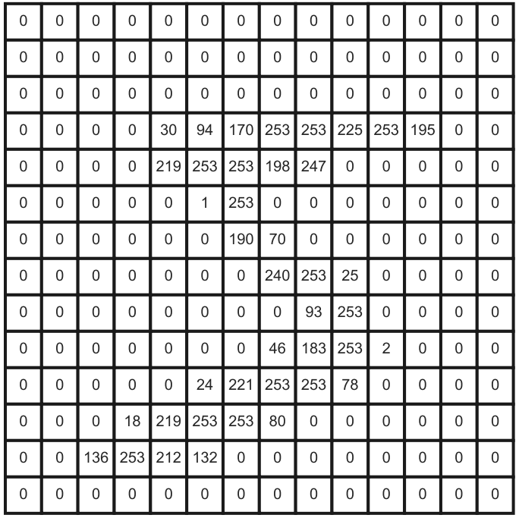
Representing data in computers
Many data are numerical in nature
Other examples
Video captures
Financial time series
Numerical measurements from experiments

Slide 20
What about general discrete data?
We make an important distinction
Ordinal data Data that has a natural notion of order, e.g.
Star ratings of a product
Level of language proficiency
Letter grades of a class
Nominal data Data that has no order, e.g.
Categories of image classification
Answers to True/False questions

Slide 21
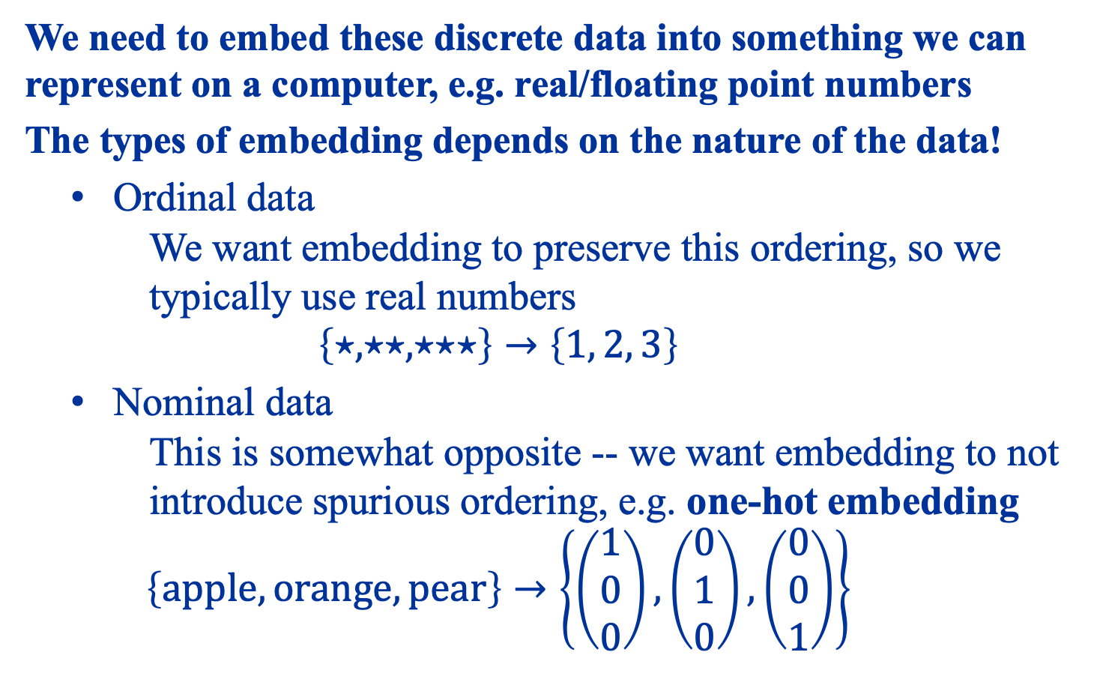
We need to embed these discrete data into something we can represent on a computer, e.g. real/floating point numbers
The types of embedding depends on the nature of the data!
Ordinal data We want embedding to preserve this ordering, so we typically use real numbers $\left\{⋆, ⋆⋆, ⋆⋆⋆\right\}→\left\{1, 2, 3\right\}$
Nominal data This is somewhat opposite -- we want embedding to not introduce spurious ordering, e.g. one-hot embedding $\left\{apple,orange,pear\right\}→\left\{\left(\begin{matrix}1 \\ 0 \\ 0\end{matrix}\right),\left(\begin{matrix}0 \\ 1 \\ 0\end{matrix}\right),\left(\begin{matrix}0 \\ 0 \\ 1\end{matrix}\right)\right\}$
Notes:
The nature depends on the application domain!

Slide 22
Classes of machine learning problems
Supervised Learning | Unsupervised Learning | Reinforcement Learning
Regression | Clustering | Value iteration
Classification | Dimensional reduction | Policy gradient
Function approximation | Generative models | Actor-critic
Inverse problems/design | Anomaly detection | Exploration
… | … | …
There are many intersections between them!
Notes:
Semi-supervised learning

Slide 23
Model evaluation and selection
Occam’s Razor
“More things should not be used than are necessary.”
Ptolemy’s Model
Kepler’s Laws
Newtonian Mechanics
Decreasing complexity and assumptions

Slide 24
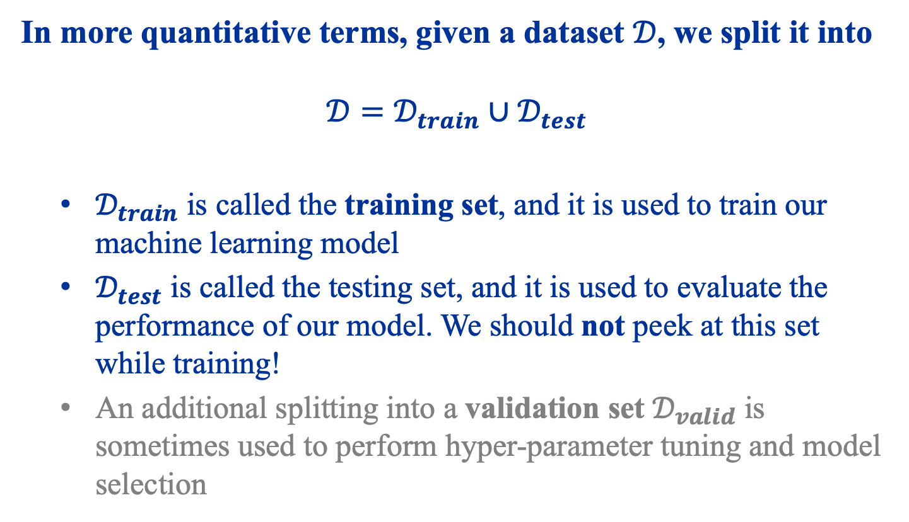
Evaluation and Selection using Data
In more quantitative terms, given a dataset $𝒟$, we split it into
$$𝒟=𝒟_{train}∪𝒟_{test}$$
$𝒟_{train}$ is called the training set, and it is used to train our machine learning model
$𝒟_{test}$ is called the testing set, and it is used to evaluate the performance of our model. We should not peek at this set while training!
An additional splitting into a validation set $𝒟_{valid}$ is sometimes used to perform hyper-parameter tuning and model selection

Slide 25
Supervised Learning

Slide 26
What is supervised learning?
Supervised learning is simplest and most prevalent type of machine learning problems
It is about learning to make predictions
Examples
Image recognition
Weather prediction
Stock price prediction
…

Slide 27
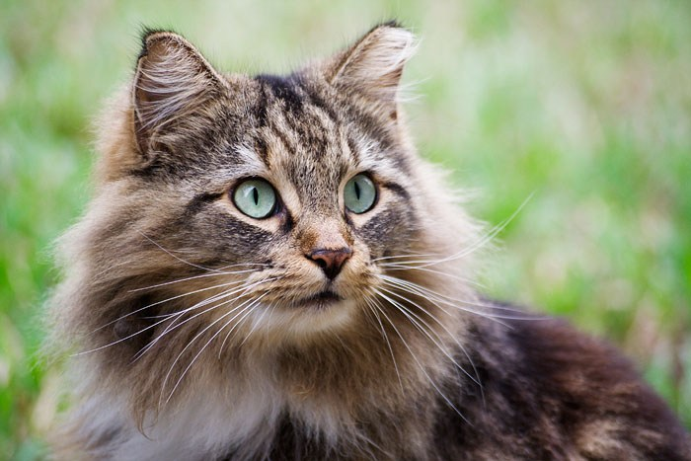
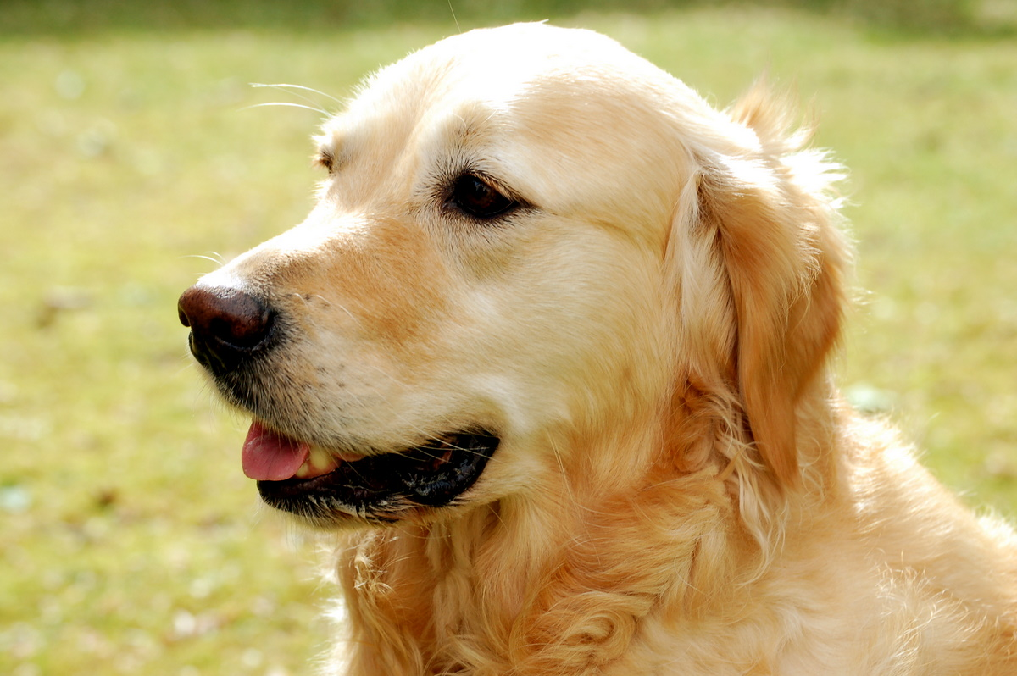
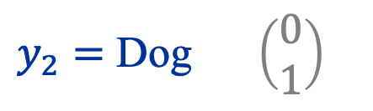
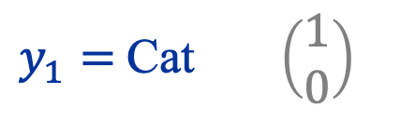
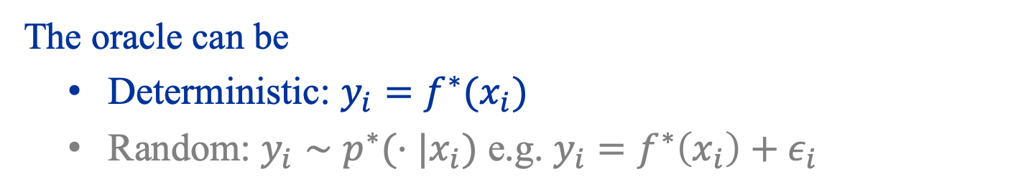
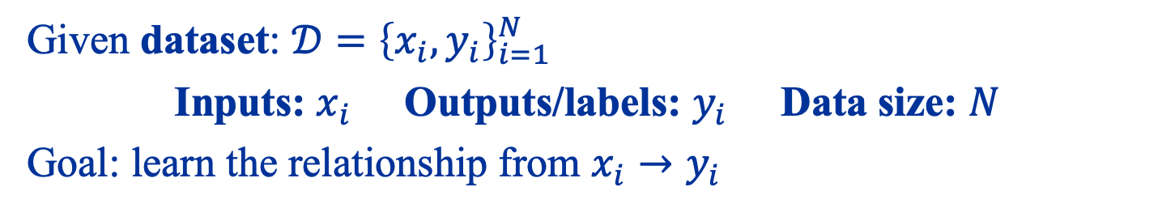
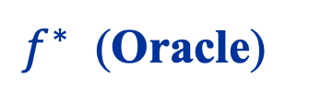


Given dataset: $𝒟={\left\{x_{i},y_{i}\right\}}_{i=1}^{N}$
Inputs: $x_{i}$ Outputs/labels: $y_{i}$ Data size: $N$
Goal: learn the relationship from $x_{i}→y_{i}$
$$x_{1}=$$
$y_{1}=$Cat $\left(\begin{matrix}1 \\ 0\end{matrix}\right)$
$$x_{2}=$$
$f^{∗}$ (Oracle)
$y_{2}=$ Dog $\left(\begin{matrix}0 \\ 1\end{matrix}\right)$
The oracle can be
Deterministic: $y_{i}=f^{∗}(x_{i})$
Random: $y_{i}∼p^{∗}(⋅|x_{i})$ e.g. $y_{i}=f^{∗}\left(x_{i}\right)+ε_{i}$

Slide 28
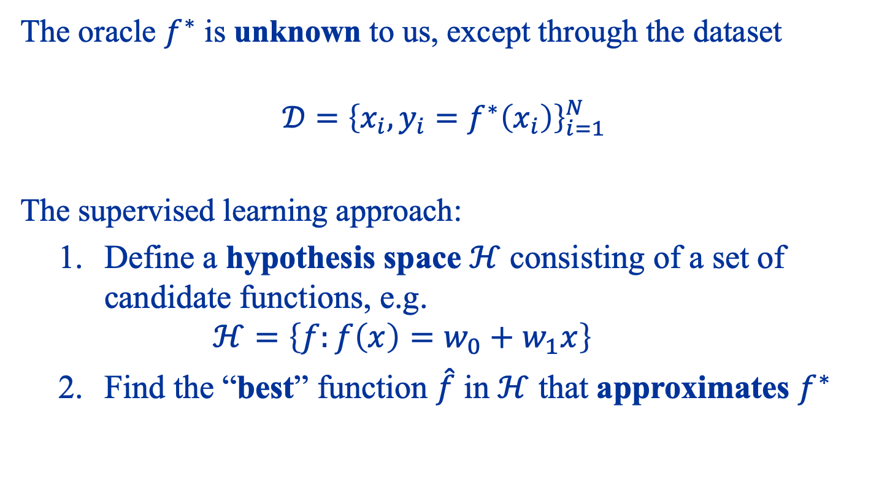
Hypothesis space
The oracle $f^{∗}$ is unknown to us, except through the dataset
$$𝒟={\left\{x_{i},y_{i}=f^{∗}\left(x_{i}\right)\right\}}_{i=1}^{N}$$
The supervised learning approach:
Define a hypothesis space $ℋ$ consisting of a set of candidate functions, e.g. $ℋ=\left\{f:f\left(x\right)=w_{0}+w_{1}x\right\}$
Find the “best” function $\hat{f}$ in $ℋ$ that approximates $f^{∗}$

Slide 29
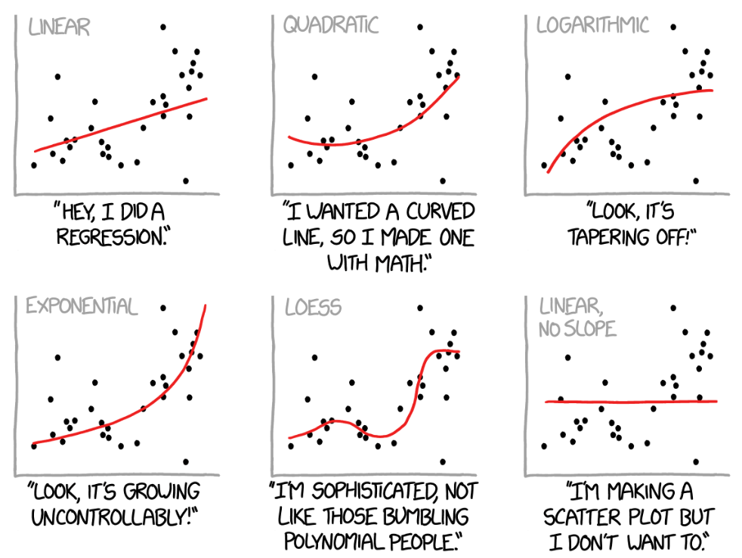
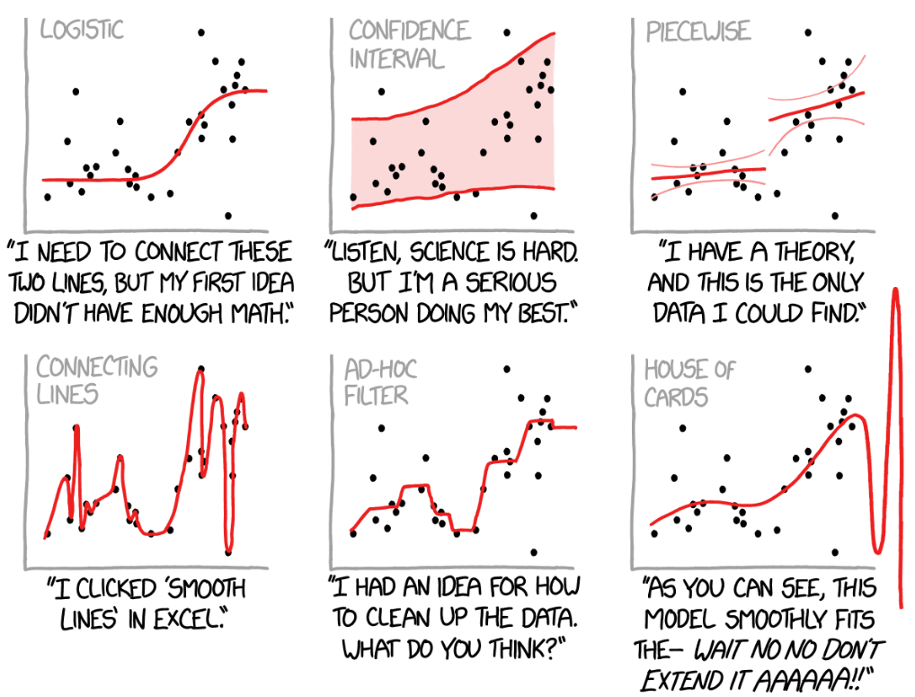

What you get depends on $ℋ$!
Curve fitting methods and the message they send. https://xkcd.com/2048/

Slide 30
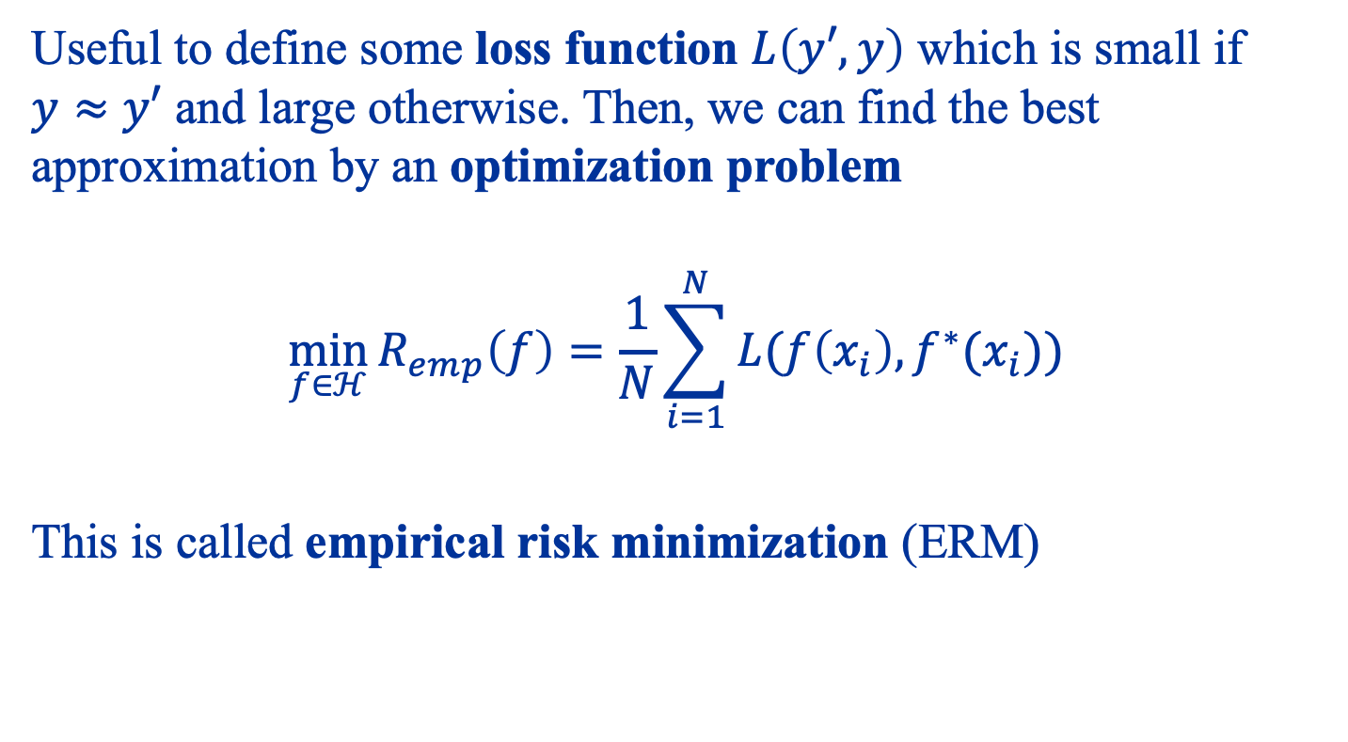
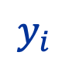
What does best approximation mean?
Useful to define some loss function $L\left(y′,y\right)$ which is small if $y≈y′$ and large otherwise. Then, we can find the best approximation by an optimization problem
$$\min_{f∈ℋ}{R_{emp}\left(f\right)=\frac{1}{N}\sum_{i=1}^{N}{L(f\left(x_{i}\right),f^{∗}(x_{i})}) }$$
This is called empirical risk minimization (ERM)
$$y_{i}$$
Notes:
Find a function from our hypothesis space that best fits the data

Slide 31

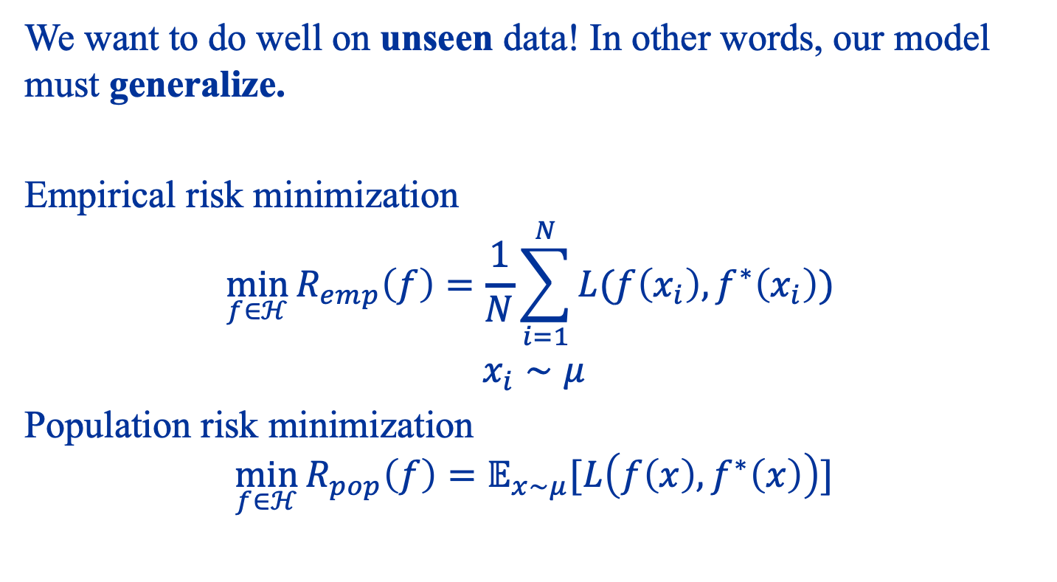


So, is learning just optimization?
We want to do well on unseen data! In other words, our model must generalize.
Empirical risk minimization
$$\min_{f∈ℋ}{R_{emp}\left(f\right)=\frac{1}{N}\sum_{i=1}^{N}{L(f\left(x_{i}\right),f^{∗}\left(x_{i}\right))} }$$
$$x_{i}∼μ$$
Population risk minimization
$$\min_{f∈ℋ}{R_{pop}\left(f\right)=𝔼_{x∼μ}[L\left(f\left(x\right),f^{∗}\left(x\right)\right)]}$$
What we can solve
Generalization Gap
$$\hat{f}$$
$$≠$$
$$\tilde{f}$$
What we really want to solve

Slide 32
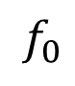
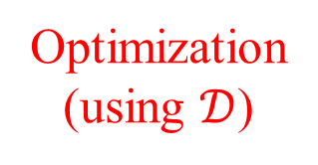
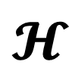
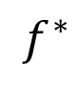
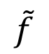
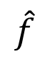
Three paradigms of supervised learning
$$f^{∗}$$
Approximation
$$𝓗$$
$$\tilde{f}$$
$$f_{0}$$
Generalization
$$\hat{f}$$
Optimization (using $𝒟$)

Slide 33
Linear Models

Slide 34
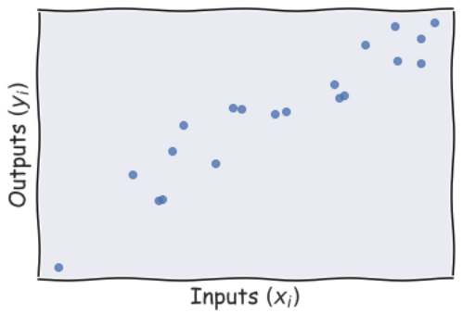
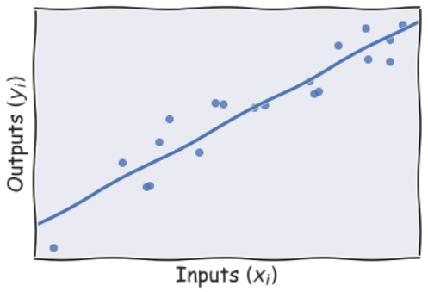
Simple linear regression
This is the simplest case, where $x_{i},y_{i}$ are all scalars

Slide 35
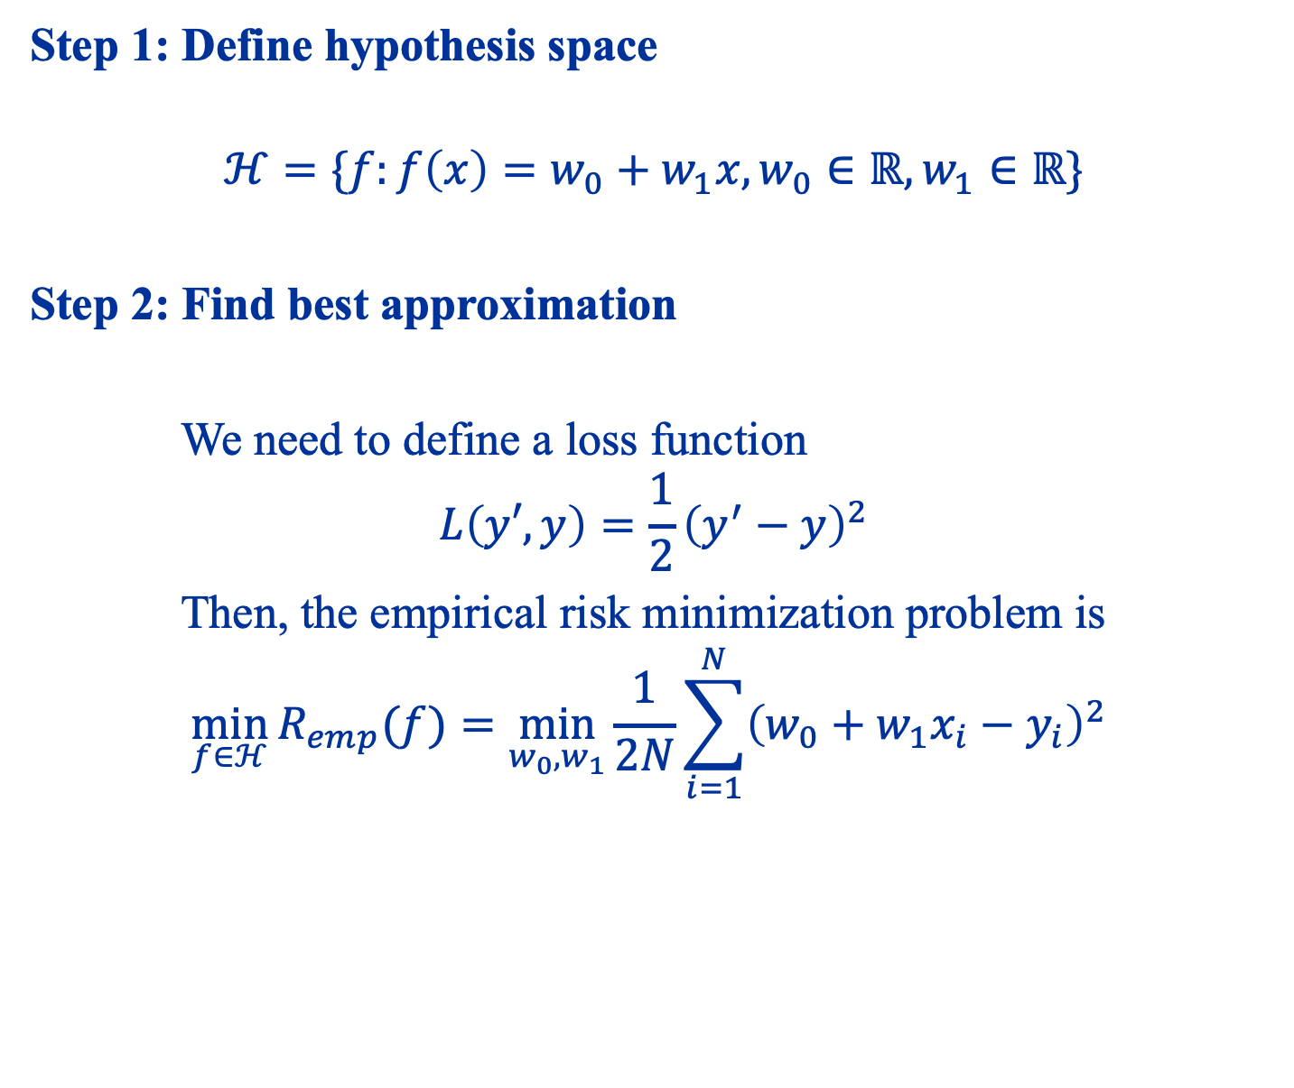
Step 1: Define hypothesis space
$$ℋ=\{f:f\left(x\right)=w_{0}+w_{1}x,w_{0}∈ℝ, w_{1}∈ℝ\}$$
Step 2: Find best approximation
We need to define a loss function
$$L\left(y′,y\right)=\frac{1}{2}{\left(y^{′}−y\right)}^{2}$$
Then, the empirical risk minimization problem is
$$\min_{f∈ℋ}{R_{emp}(f)}=\min_{w_{0},w_{1}}{\frac{1}{2N}\sum_{i=1}^{N}{{\left(w_{0}+w_{1}x_{i}−y_{i}\right)}^{2} }}$$

Slide 36
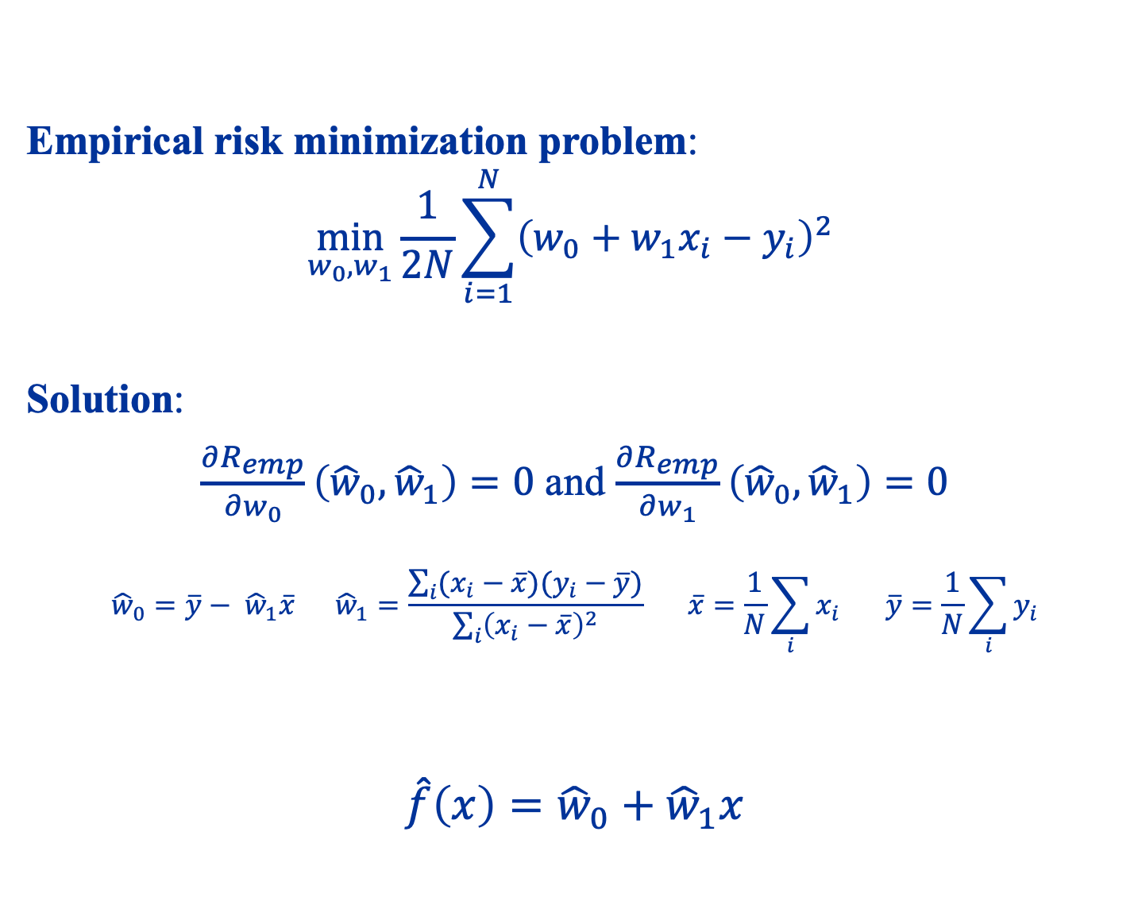
Empirical risk minimization problem:
$$\min_{w_{0},w_{1}}{\frac{1}{2N}\sum_{i=1}^{N}{{\left(w_{0}+w_{1}x_{i}−y_{i}\right)}^{2} }}$$
Solution:
$\frac{∂R_{emp}}{∂w_{0}}\left({\hat{w}}_{0},{\hat{w}}_{1}\right)=0$ and $\frac{∂R_{emp}}{∂w_{1}}\left({\hat{w}}_{0},{\hat{w}}_{1}\right)=0$
$${\hat{w}}_{0}={\overline{y}− \hat{w}}_{1}\overline{x} {\hat{w}}_{1}=\frac{\sum_{i}{(x_{i}−\overline{x})(y_{i}−\overline{y})}}{\sum_{i}{{\left(x_{i}−\overline{x}\right)}^{2}}} \overline{x}=\frac{1}{N}\sum_{i}{x_{i}} \overline{y}=\frac{1}{N}\sum_{i}{y_{i}}$$
$$\hat{f}\left(x\right)={\hat{w}}_{0}+{\hat{w}}_{1}x$$
Ordinary Least Squares Formula (1D)

Slide 37
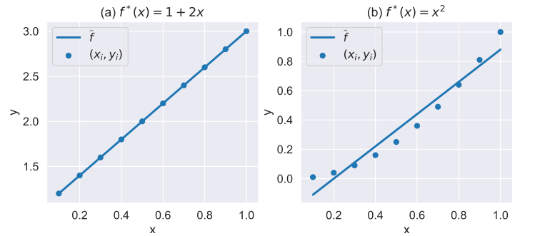
Approximation
Is the linear hypothesis space large enough?
This right figure is an instance of under-fitting

Slide 38
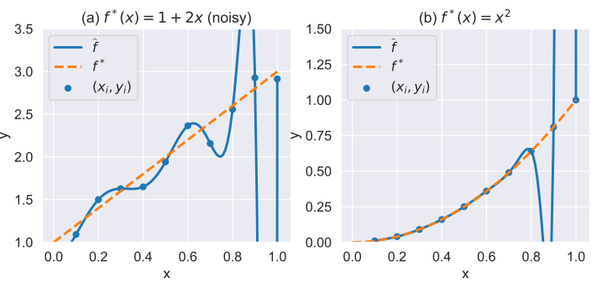
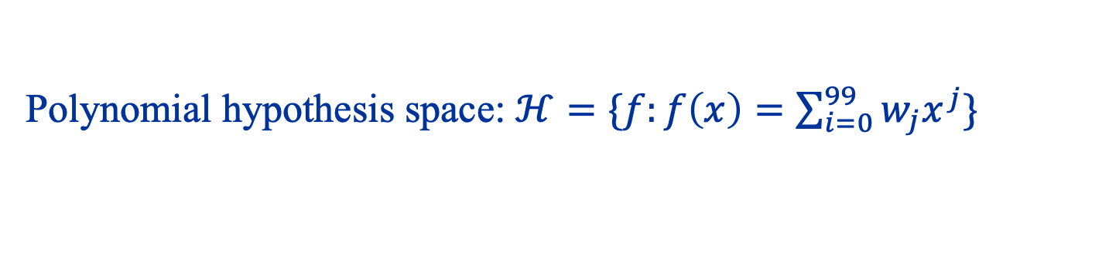
Overfitting and generalization
Polynomial hypothesis space: $ℋ=\{f:f\left(x\right)=\sum_{i=0}^{99}{w_{j}x^{j}}\}$
Hypothesis space too big, so over-fitting can happen, with or without noise!
Notes:
The difference between the orange and blue curves are generalization gaps!

Slide 39
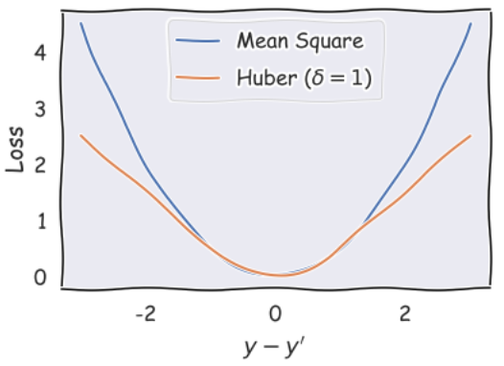
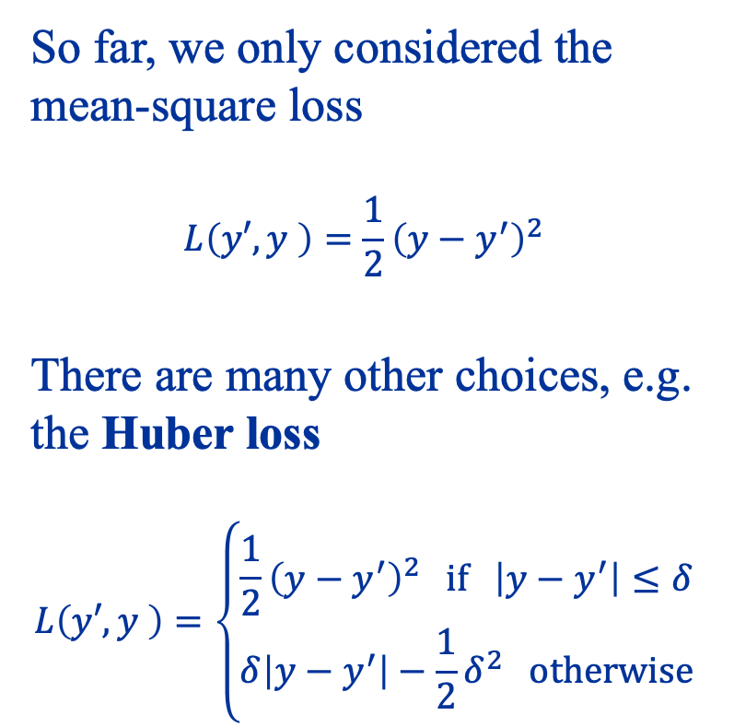
The role of loss functions
So far, we only considered the mean-square loss
$$L\left(y′,y \right)=\frac{1}{2}{\left(y−y^{′}\right)}^{2}$$
There are many other choices, e.g. the Huber loss
$$L\left(y′,y \right)=\left\{\begin{aligned}\frac{1}{2}{\left(y−y^{′}\right)}^{2} if \left|y−y^{′}\right|≤δ \\ δ\left|y−y^{′}\right|−\frac{1}{2}δ^{2} otherwise\end{aligned}\right.$$

Slide 40
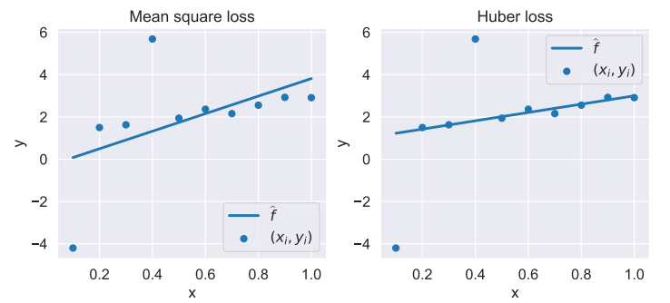
Mean square vs Huber loss in regression
We perform a linear regression on a noisy dataset with outliers. What do you observe?

Slide 41
General linear basis models
The simple linear regression we have seen is quite limited
Only for 1D inputs
Can only fit linear relationships
It turns out that we can easily generalize the previous approach by considering linear basis models

Slide 42
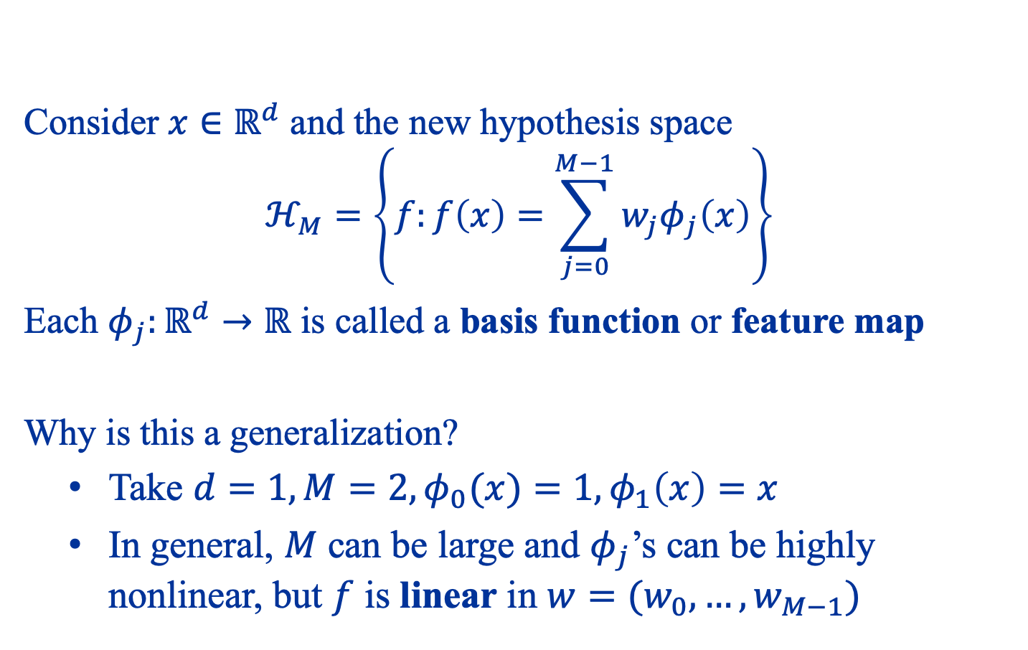
General linear basis models
Consider $x∈ℝ^{d}$ and the new hypothesis space
$$ℋ_{M}=\left\{f:f\left(x\right)=\sum_{j=0}^{M−1}{w_{j}φ_{j}\left(x\right)}\right\}$$
Each $φ_{j}:ℝ^{d}→ℝ$ is called a basis function or feature map
Why is this a generalization?
Take $d=1,M=2,φ_{0}(x)=1,φ_{1}\left(x\right)=x$
In general, $M$ can be large and $φ_{j}$’s can be highly nonlinear, but $f$ is linear in $w=(w_{0},…,w_{M−1})$

Slide 43
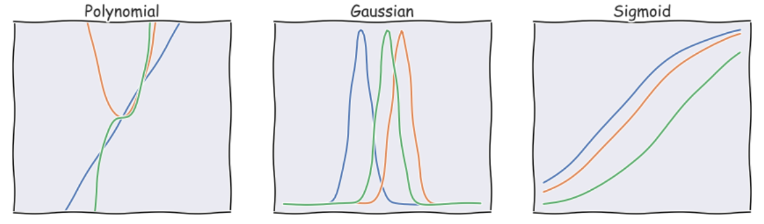
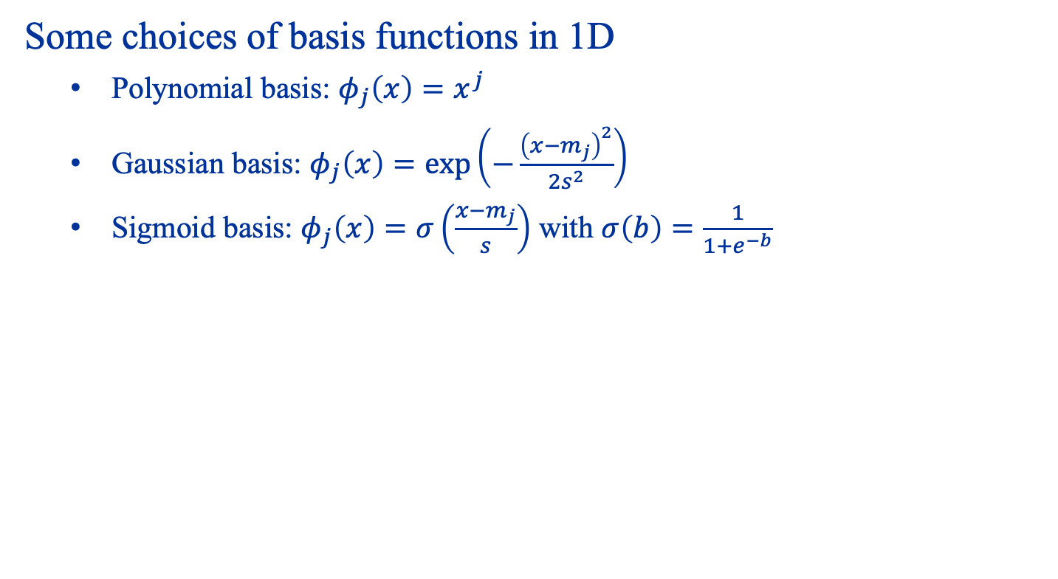
Examples of basis functions
Some choices of basis functions in 1D
Polynomial basis: $φ_{j}\left(x\right)=x^{j}$
Gaussian basis: $φ_{j}\left(x\right)=\exp\left(−\frac{{\left(x−m_{j}\right)}^{2}}{2s^{2}}\right)$
Sigmoid basis: $φ_{j}\left(x\right)=σ\left(\frac{x−m_{j}}{s}\right)$ with $σ\left(b\right)=\frac{1}{1+e^{−b}}$

Slide 44
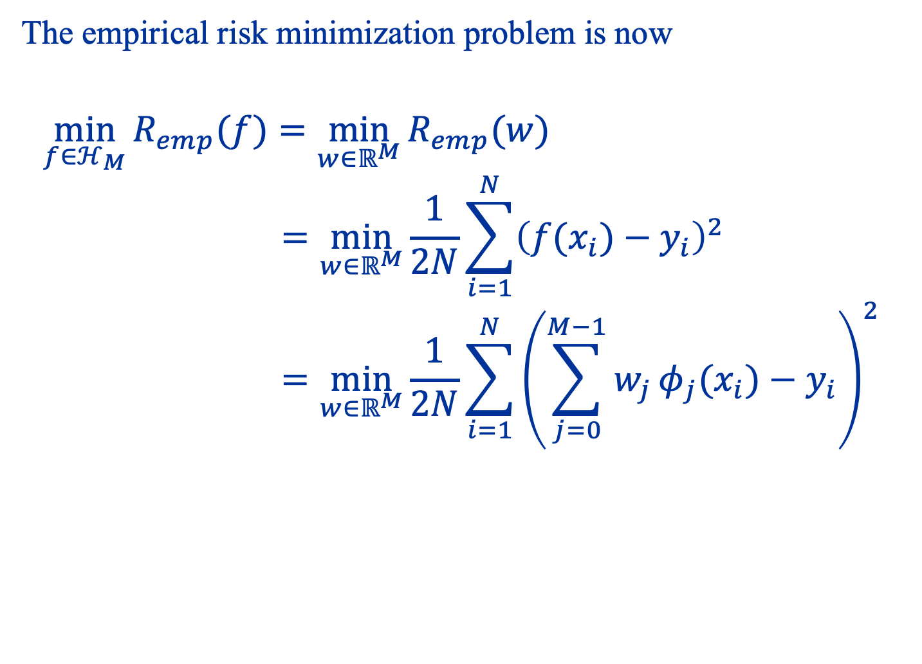
Ordinary least squares for linear basis models
The empirical risk minimization problem is now
$$\min_{f∈ℋ_{M}}{R_{emp}(f)}=\min_{w∈ℝ^{M}}{R_{emp}(w)} \\ =\min_{w∈ℝ^{M}}{\frac{1}{2N}\sum_{i=1}^{N}{{\left(f(x_{i})−y_{i}\right)}^{2} }} \\ =\min_{w∈ℝ^{M}}{\frac{1}{2N}\sum_{i=1}^{N}{{\left(\sum_{j=0}^{M−1}{w_{j}}φ_{j}(x_{i})−y_{i}\right)}^{2} }}$$

Slide 45
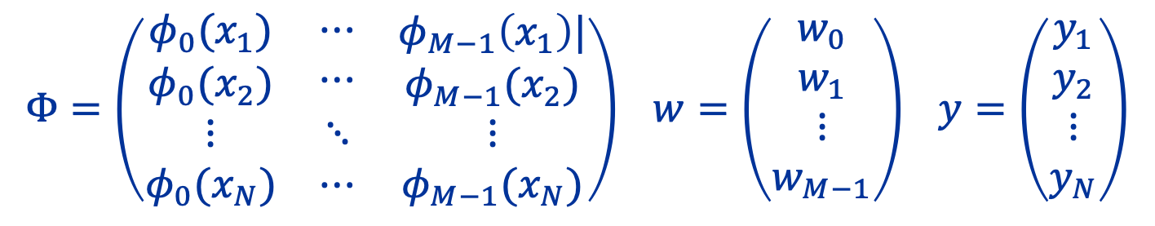

We can rewrite
$$\min_{w∈ℝ^{M}}{\frac{1}{2N}\sum_{i=1}^{N}{{\left(\sum_{j=0}^{M−1}{w_{j}}φ_{j}(x_{i})−y_{i}\right)}^{2} }}$$
in compact form
$$\min_{w∈ℝ^{M}}{\frac{1}{2N}‖Φw−y{\left.​\right\|}^{2}}$$
$$Φ=\left(\begin{matrix}\begin{aligned}φ_{0}(x_{1}) \\ φ_{0}(x_{2})\end{aligned} & \begin{aligned}⋯ \\ ⋯\end{aligned} & \begin{aligned}φ_{M−1}\left(x_{1}\right)| \\ φ_{M−1}(x_{2})\end{aligned} \\ ⋮ & ⋱ & ⋮ \\ φ_{0}(x_{N}) & ⋯ & φ_{M−1}(x_{N})\end{matrix}\right) w=\left(\begin{aligned}w_{0} \\ w_{1} \\ ⋮ \\ w_{M−1}\end{aligned}\right) y=\left(\begin{aligned}y_{1} \\ y_{2} \\ ⋮ \\ y_{N}\end{aligned}\right)$$

Slide 46

We want to solve
$$\min_{w∈ℝ^{M}}{\frac{1}{2N}‖Φw−y{\left.​\right\|}^{2}}$$
We can do this by setting $∇R_{emp}\left(\hat{w}\right)=0$.
Suppose$Φ^{T}Φ$ is invertible, then we have
$$Φ^{T}\left(Φ\hat{w}−y\right)=0$$
Rearranging we have
$$\hat{w}={\left(Φ^{T}Φ\right)}^{−1}Φ^{T}y$$
What happens if $Φ^{T}Φ$ is not invertible, i.e. it is singular?
General Ordinary Least Squares Formula

Slide 47

In the singular case, we have an infinite number of solutions, all of which have $R_{emp}\left(\hat{w}\right)=0$. They are given by
$$\hat{w}\left(u\right)=Φ^{†}y+\left(I−Φ^{†}Φ\right)u u∈ℝ^{M}$$
Here, $Φ^{†}$ denotes the Moore-Penrose pseudoinverse of $Φ$.
How do we pick a solution?

Slide 48

Regularization
Often, it is advantageous to consider the regularized least squares problem
$$\min_{w∈ℝ^{M}}{\frac{1}{2N}‖Φw−y{\left.​\right\|}^{2}+λC(w)}$$
Types of regularization
$ℓ^{2}$ regularization: $C\left(w\right)={\left\|w\right\|}^{2}$ (ridge regression)
$ℓ^{1}$ regularization: $C\left(w\right)={\left\|w\right\|}_{1}=\sum_{j}{|w_{j}|}$ (least absolute shrinkage and selection operator, or lasso)
…
regularizer

Slide 49


Regularization and generalization
We apply $ℓ^{2}$ regularization on the over-fitting examples
Recall:
$ℋ_{M}=\left\{f:f\left(x\right)=\sum_{i=0}^{99}{w_{j}x^{j}}\right\}$ so $M=100$, but $N=10$
Without regularization
With regularization

Slide 50

Classification using linear basis models
In $K$-class classification problems, each $y_{i}$ takes on the class label of one of $K$ classes.
We will use the one-hot encoding introduced earlier to represent each $y_{i}$ that belongs to class $k$ as
$$y_{i}=\left(0, …,0, 1, 0,…,0\right)∈ℝ^{K}$$
k^{th} Position

Slide 51

We require a slight change of hypothesis space
$$ℋ_{M}=\left\{f:f\left(x\right)=g\left(\sum_{i=0}^{M−1}{w_{j}φ_{j}\left(x\right)}\right),w_{j}∈ℝ^{K}\right\}$$
The function $g:ℝ^{K}→ℝ^{K}$ is called an activation function, and the most commonly used one is the soft-max function
$$g{\left(z\right)}_{k}=\frac{\exp\left(z_{k}\right)}{\sum_{j}{\exp\left(z_{j}\right)}}$$
Notice that $g$ always outputs a vector which can be interpreted as probabilities over $K$ classes

Slide 52

Everything else remain the same, and we can define the empirical risk minimization problem for classification as
$$\min_{W∈ℝ^{M×K}}{R_{emp }\left(W\right)=}\min_{W∈ℝ^{M×K}}\frac{1}{N}\sum_{i=1}^{N}{L\left(g{\left(ΦW\right)}_{i},y_{i}\right)}$$
What loss function should we use? We can always use mean square loss, but there is a better choice: the cross-entropy loss
$$L\left(y^{′},y\right)=−\sum_{k=1}^{K}{y_{k}\log{y_{k}^{′}}}$$
Notes:
Why cross entropy over mean-square?
Make sense to compare probabilities
From the statistical viewpoint, doing MSE involves assuming the noise is Gaussian, whereas CE assumes the noise is multinomial
Numerically stable

Slide 53
Demo: Applications of Linear Models

Slide 54




A Cautionary Note on Correlation
More examples at https://www.tylervigen.com/spurious-correlations

Slide 55
Summary
Machine learning vs AI
Types of Learning Problems
Supervised learning
Unsupervised learning
Reinforcement learning
Linear models as a baseline for supervised learning

Slide 56
Useful Tools
Version control with Git
https://www.freecodecamp.org/news/what-is-git-and-how-to-use-it-c341b049ae61/
Interactive python with Jupyter notebooks
https://www.datacamp.com/community/tutorials/tutorial-jupyter-notebook
Data visualization using Seaborn and Pandas
https://jakevdp.github.io/PythonDataScienceHandbook/04.14-visualization-with-seaborn.html

Slide 57
Further Reading
Matrix Cookbook
https://www.math.uwaterloo.ca/~hwolkowi/matrixcookbook.pdf
More on linear models (Pattern Recognition and Machine Learning, Bishop)
http://users.isr.ist.utl.pt/~wurmd/Livros/school/Bishop%20-%20Pattern%20Recognition%20And%20Machine%20Learning%20-%20Springer%20%202006.pdf

